Slide 1
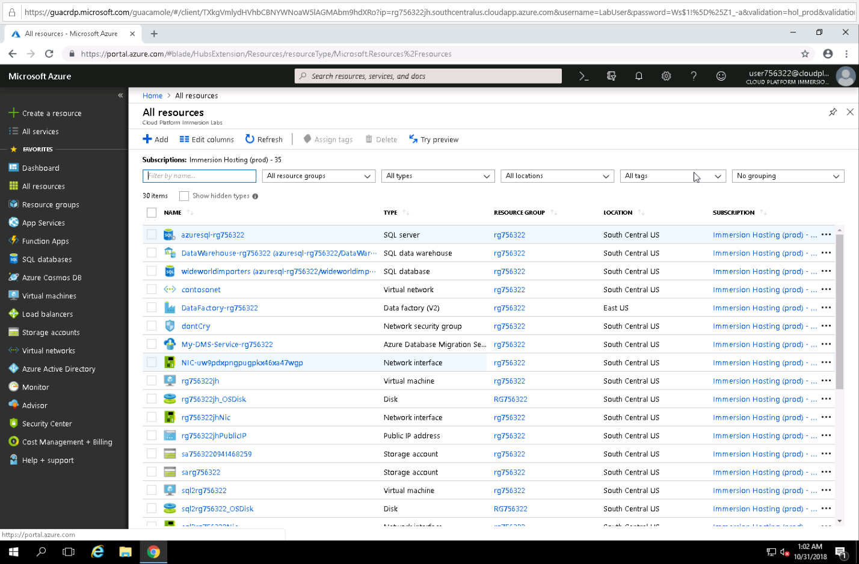
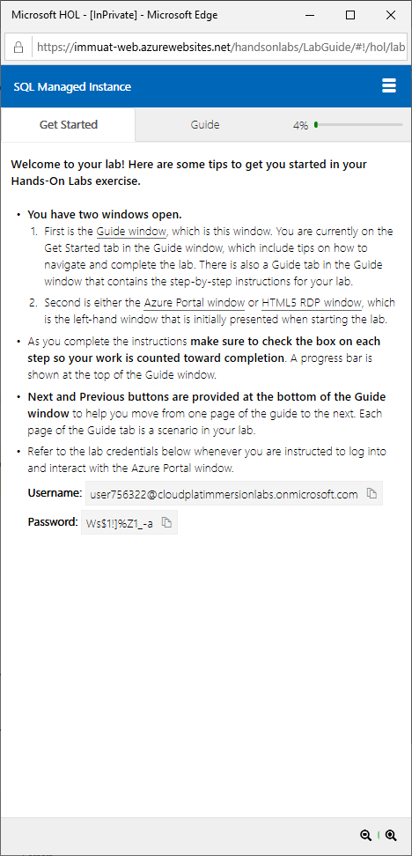
Azure SQL DB Managed Instance labs
Tiny URL: http://tinyurl.com/yaju8q5p
Use InPrivate browser
Introduction to SQL Managed Instance
Migration using SQL Managed Instance
SQL Managed Instance data integration and business intelligence

Slide 2

Ho to request a lab session
Send a request to Valorem
Specify the number of seats, location & date
Receive a calendar invite for lab sessions
Receive Tiny URL two hours prior event start time
 | Marc Tangvik Operations Analyst e: mtangvik@valorem.com
Number of seats:
Location (city):
Date:
Start Time:
End Time:
http://tinyurl.com/yaju8q5p

Slide 3


Introduction to SQL Managed Instance This lab demonstrates how to create an Azure SQL Database Managed Instance using the Azure Portal in a dedicated subnet of a virtual network. You will learn how to configure networks, security capabilities, and privacy capabilities of your Managed Instance. You will also understand how to size your MI, create disaster recovery protections, and manage & monitor security and performance tuning.
HOL
LAB
Notes:
Search for lab title on https://immtest-web.azurewebsites.net/handsonlabs
Steps in lab:
Create a Virtual Network
Create MI subnet
Create VM subnet
Create a new route table and a route
Apply the route table to the Managed Instance subnet
Create Managed Instance

Slide 4
Migrate Using SQL Managed Instance This lab demonstrates how to migrate a SQL database to a Azure SQL Database Managed Instance using the Azure Database Migration Service.
HOL
LAB
Notes:
Search for lab title on https://immtest-web.azurewebsites.net/handsonlabs
Steps in lab:
Create an Instance of Azure DMS – (some) prep steps
Create an Instance of Azure Data Migration Services
Create Storage SAS URI for DMS Migration Project
Create and Run a Migration Project
Navigate to the SQL Managed Instance Database

Slide 5
SQL Managed Instance data integration and business intelligence Learn to control the seamless orchestration of your enterprises' data integration efforts through an extensive tour of Azure Data Factory.
HOL
LAB
Notes:
Search for lab title on https://immtest-web.azurewebsites.net/handsonlabs
Steps in lab:

Slide 6
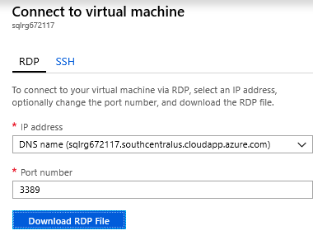
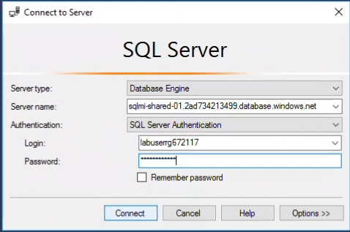
Connecting to lab Azure SQL DB Managed Instance
From Lab 2 – “Migration Using SQL Managed Instance”
RDP Username = labuser
RDP Password = Lab password
To connect to SQL MI use SSMS
SQL MI TEST = sqlmi-shared-01-test.568ebab56ce1.database.windows.net
SQL MI User = LabUser + resource group name ie (LabUserrg188393)
SQL MI password = Lab password (same as RDP password)

